Slide 1
Statistical analysis of ECG signal for mycardial ischaemia

Slide 2
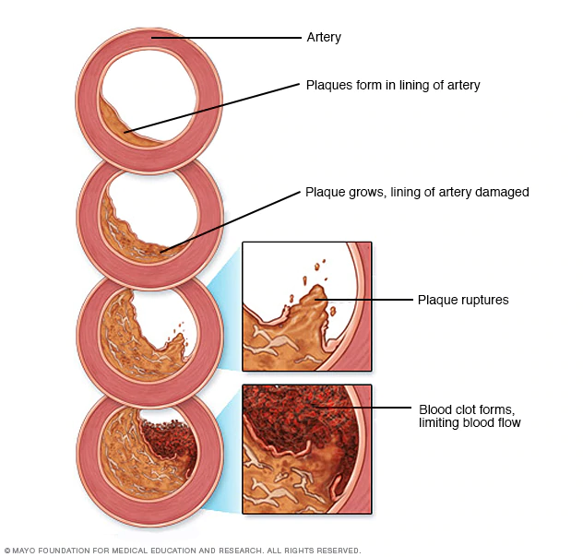
Introduction:
Myocardial ischemia occurs when blood flow to the heart is reduced, preventing the heart muscle from receiving enough oxygen. The reduced blood flow is usually the result of a partial or complete blockage of the heart's arteries (coronary arteries).
Myocardial ischemia, also called cardiac ischemia, reduces the heart muscle's ability to pump blood. A sudden, severe blockage of one of the heart's artery can lead to a heart attack. Myocardial ischemia might also cause serious abnormal heart rhythms.
Symptoms:
Some people who have myocardial ischemia don't have any signs or symptoms (silent ischemia).
Signs and symptoms which might be experienced :
chest pressure or pain(typically on the left side of the body)
Neck or jaw pain
Shoulder or arm pain
A fast heartbeat
Shortness of breath when you are physically active
Nausea and vomiting
Sweating
Fatigue
Causes: Conditions that can cause myocardial ischemia include:
Coronary artery disease (atherosclerosis). Plaques made up mostly of cholesterol build up on your artery walls and restrict blood flow.

Slide 3
Blood clot. The plaques that develop in atherosclerosis can rupture, causing a blood clot.
Coronary artery spasm(Uncommon Cause). This temporary tightening of the muscles in the artery wall can briefly decrease or even prevent blood flow to part of the heart muscle.
Chest pain associated with myocardial ischemia can be triggered by:
1.Physical exertion 2.Emotional stress 3.Cold temperatures 4.Cocaine use 5.Eating a heavy or large meal
6.Sexual intercourse
Risk factors:
1.Tobacco 2.Diabetes 3.High blood pressure 4.High blood cholesterol level 5.High blood triglyceride level 6.ObesityWaist circumference 7.Lack of physical activity
Complications:
Heart attack
Irregular heart rhythm (arrhythmia)
Heart failure
Treatment:
Treatment for myocardial ischemia involves improving blood flow to the heart muscle. Treatment may include medications, a procedure to open blocked arteries (angioplasty) or bypass surgery.

Slide 4
Electrocardiogram (ECG):
Our nerve and muscle cells communicate with each other using electrical and chemical signals. Regular electrical signals also control our heartbeat. These signals are sent by a group of cells in the right atrium of the heart known as the sinoatrial node (SA node), and they spread through the heart muscle tissue as tiny electrical impulses. This causes first the atria and then the ventricles of the heart to contract. The way that these signals spread through the heart can also be measured on the surface of our skin. An ECG measures these changes in electrical signals (or, in fact, voltage) on different areas of skin and plots them as a graph. The resulting ECG graph is called an electrocardiogram.
It mainly records how often the heart beats (heart rate) and how regularly it beats (heart rhythm).
The ECG Test Involves:
The electrical activity of the heart can be measured on the surface of the skin – even as far from the heart as on the arms or legs. The standard “12-lead ECG” uses a total of ten electrodes: six on your chest, and then one each on the lower arms and calves.
Types of ECG tests:
Resting ECG: This involves lying still on your back with a bare chest.
Exercise ECG: Here the electrical activity of your heart is measured while you are physically active.
Holter monitor: The electrical activity of the heart is typically recorded over a period of 24 hours. Three or four electrodes are attached to your chest, and a small recording device is worn on a belt or hung around your neck.
The results of a 12-lead ECG show:
The 12-lead ECG takes advantage of the fact that signals sent by the heart don't travel evenly over the skin. The device compares the strength of the signals between two electrodes called “leads.”

Slide 5
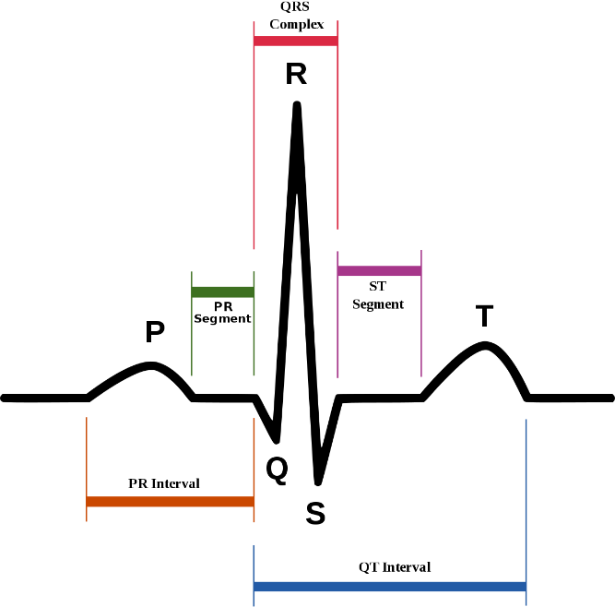
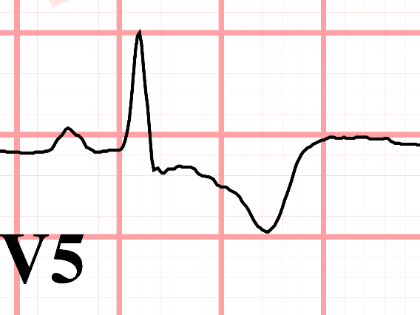
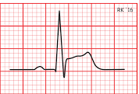
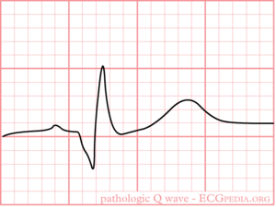
For example, one of the leads is measured based on the two electrodes on your arms. A 12-lead ECG, as its name implies, is used to measure twelve leads. Depending on which lead shows irregularities, experts can find out things like in which part of the heart muscle an infarction has occurred, or whether a heart rhythm problem is coming from the left or right ventricle.
In Myocardial Infraction changes in ECG are:
ST segment elevation.
T wave inversion
Appearance of wide deep Q waves.
T wave inversion
ST Segment Elevation
Wide deep Q waves
Normal ECG
Abnormal ECG

Slide 6
Previous Work
https://www.banglajol.info/index.php/BJMP/article/download/39147/26626
https://link.springer.com/article/10.1007/s10489-018-1179-1

Slide 8
Our solution

Slide 9
Work done till now

Slide 10
How we can proceed further from this step

Slide 11
References

Slide 12
Thank you

